Slide 1

EOS
The blockchain for business is the blockchain that solves the black swan
Presented by

Slide 2
Disclaimer
We are NOT in any way associated with block.one, the company developing EOS code. We are just part of the emerging EOS community.
We have no interest in you buying EOS tokens, and this certainly should not be treated as financial advice.
Our goal is to encourage you to take interest in the concept and possibly consider building businesses on top of EOS.

Slide 3
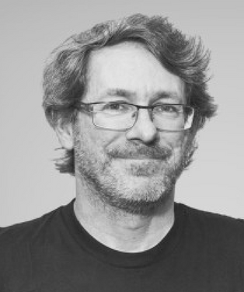
CREDITS
Ian Grigg has been in the financial cryptography space since 1995, when he ran a startup to issue and trade bonds digitised as contracts. Since then he has worked on digitising cash, precious metals, identity, social savings, and bringing DLT to financial institutions. He is now working on a number of blockchain and DLT related projects including EOS.

Slide 4
TWO ALTERNATIVE FORMS OF BLOCKCHAIN
Unpermissioned Blockchain
Permissioned Blockchain

Slide 5
UNPERMISSIONED blockchains
Bitcoin & Ethereum
Designed to do simple automation only: simple contractual mechanisms
Emphasis on smart-contracts & external oracles to feed information in
When it comes to the actual business: anarchy & „wild west”

Slide 6
PERMISSIONED blockchains
Ripple & Hyperledger
Ideally suited for banks & large institutions
Paradigm of a walled garden: you can get in only if you're permitted in
Rules to suit the insiders, small businesses get locked out

Slide 7
TRADING = DEALING WITH COMPLEXITY
We like complexity, we like a risky business
Complexity means lots of things can go wrong, especially on a blockchain
Black Swan: happens very infrequently but it’s extremely costly

Slide 8
THE PROBLEM WITH black SWAN
In real-life there are safety mechanisms, i.e. legal infrastructure
On a blockchain: no safety net, e.g. the DAO incident
Unpermissioned blockchain encourages win-lose / zero-sum game:
if you want to get ahead in a trade, let's do a DDoS
if you want to get ahead with a contract, let’s hack the contract

Slide 9
WHAT DOES THE BUSINESS NEED?
We're looking for a repeated, no-end-in-sight game
We want to remember who we are dealing with
We need rules of the game & we need a way to hold a violator to account
We need a win-win / net-positive game

Slide 10
The entrepreneur wants a business where they can deal with people and build profits, not extract profits.
Ian Grigg, block.one partner

Slide 11
The blockchain for business is the blockchain that solves the black swan.
Ian Grigg, block.one partner

Slide 12
WHAT We need IS a governed blockchain

Slide 13
HOW DO WE BUILD a GOVERNED BLOCKCHAIN?
Set of rules: the constitution
The community is the people who have agreed to the constitution
Entire governance infrastructure:
referenda to appoint the rules to handle black swans
arbitration to resolve disputes
execution to implement to rules

Slide 14
SUMMARY
The unpermissioned blockchain:
The entrepreneur is looking for win-win, but he gets win-lose
It’s about taking the value from the other person
The permissioned blockchain
Concentrates on blocking people out, so that the ones that are inside can safely trade
The problem: you can't have a vibrant growing economy without small business
We need the freedom of (1) but still the protection offered by (2).

Slide 15
EOS is that third choice, the governed blockchain. In essence what we have is the safety taken from the permissioned blockchain, and the freedom of entry taken from the unpermissioned blockchain
Ian Grigg, block.one partner

Slide 16
The fallacy is that we need a wall. Actually, we don't need a wall. What we need is controls.
Ian Grigg, block.one partner

Slide 17
WHAT We ALSO need IS GOOD USER experience

Slide 18
EOS is the blockchain for building commercial scale decentralized applications that are indistinguishable from centralized alternatives.
Daniel Larimer, CTO of block.one

Slide 19
What are eos main features?
Infrastructure for apps
Upgradeable apps
Inter-blockchain communication
No transaction fees
Processing power
Built-in governance

Slide 20
DPOS - DELEGATED PROOF OF STAKE
21 block producers elected by token holders
Hard to get elected, easy to lose the job
Both executors of the constitution and subjects to the constitution
Ability to freeze & fix broken dApps
Extremely resilient & very low latency

Slide 21
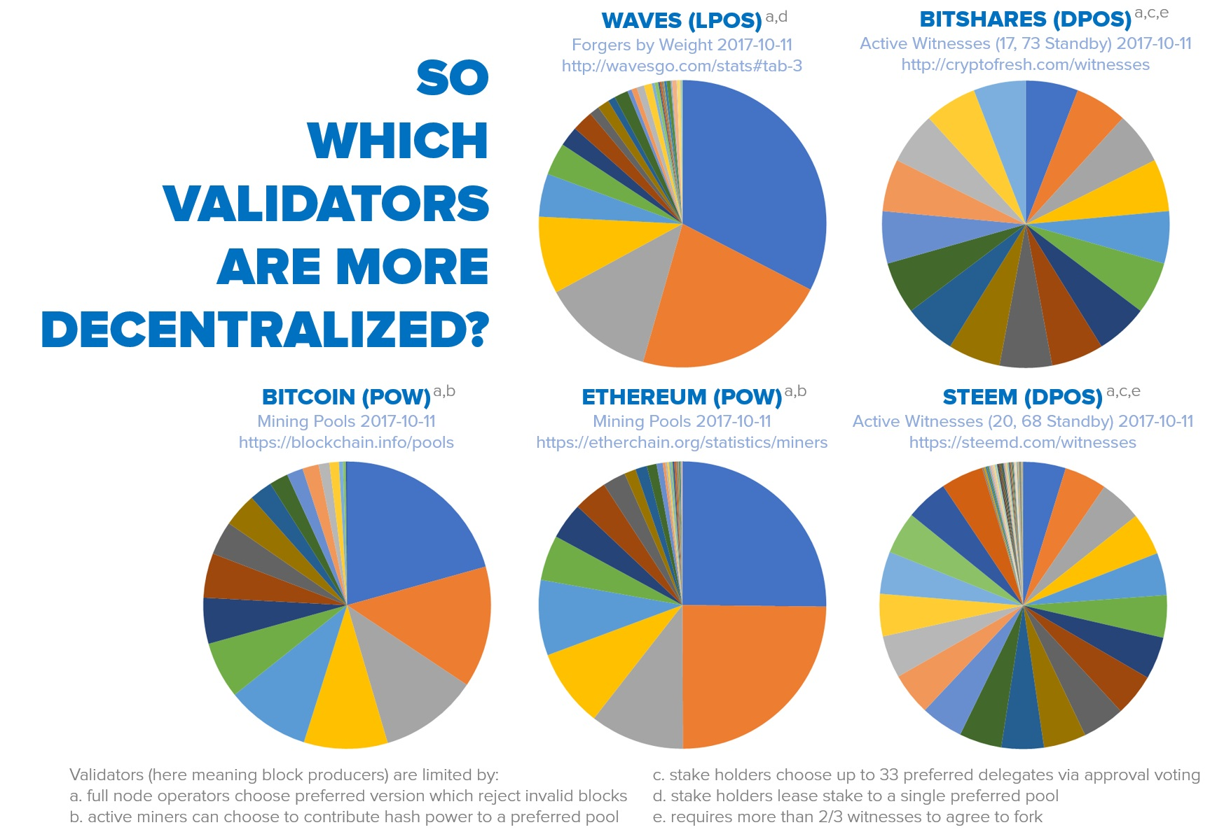
Delegated proof of stake (DPOS) HOW decentralized IS IT?
Source: senzheng on reddit.com

Slide 22
IS FULLY autonomous SYSTEM Possible?
Vitalik Buterin: governance by cryptoeconomics. If we could only put the right algorithm inside a box, then it could be fully self-suffcient.
Daniel Larimer: governance by community. There is no such thing as a closed economic system, we must always rely on external input, i.e. human judgement.

Slide 23
DAN Larimer’s Darwinian approach
Each community might have its own definition of “right and wrong” which can only be measured by a poll of the subjective opinions of community members
The more effective a group is at maintaining its integrity as it grows, the larger the group will grow
The more corrupt a group is, the faster it will die

Slide 24
The true goal is to lower the barrier to entry for the creation of new communities and allow free market competition to reward the most effective communities and punish the most corrupt.
Daniel Larimer, CTO of block.one

Slide 25
Processing power
Source: eos.io

Slide 26
BLOCKCHAIN Evolution
System for simple payments (Bitcoin)
System for smart-contracts (Ethereum)
System for decentralized apps (EOS)

Slide 27
HOW DOES EOS WORK?
Applications
Operating System
Computer

Slide 28
HOW DOES EOS WORK?
Applications
Operating System
EOS
Computer

Slide 29
What does A decentralized app require?
High performance
Free for the users
Easily accessible
No fancy cryptographic stuff
Bug recovery
Upgradability
Account recovery
Privacy protection
Access to other blockchains

Slide 30


EOS VS. decentralized apps requirements
Ethereum |  | EOS
 | High performace
 | Free for the users
 | Easily accessible
? | No fancy cryptographic stuff
 | Account recovery
 | Privacy protection | ?
? | Access to other blockchains
? | Upgradability
 | Bug recovery

Slide 31
TWO Different WAYs OF Building A Smart-contract platform
From abtract to concrete
From concrete to abstract

Slide 32
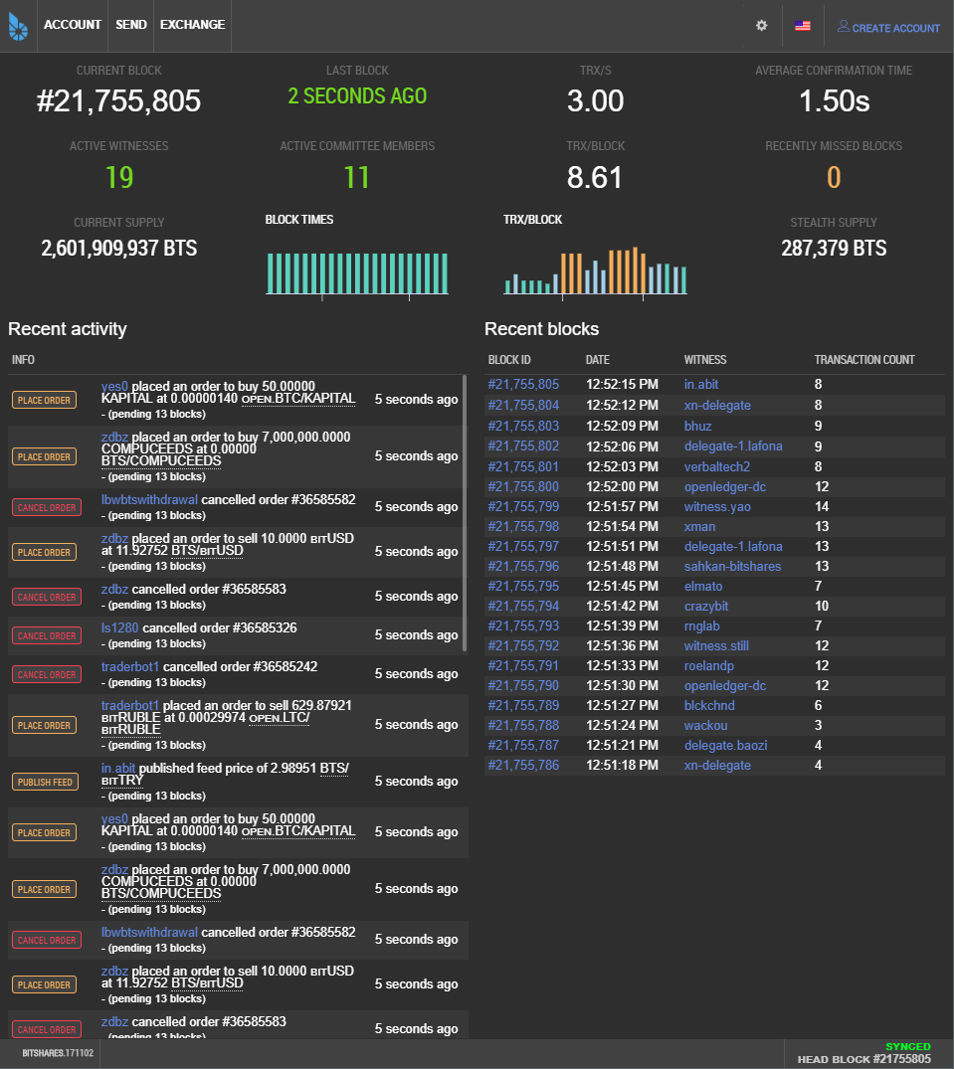
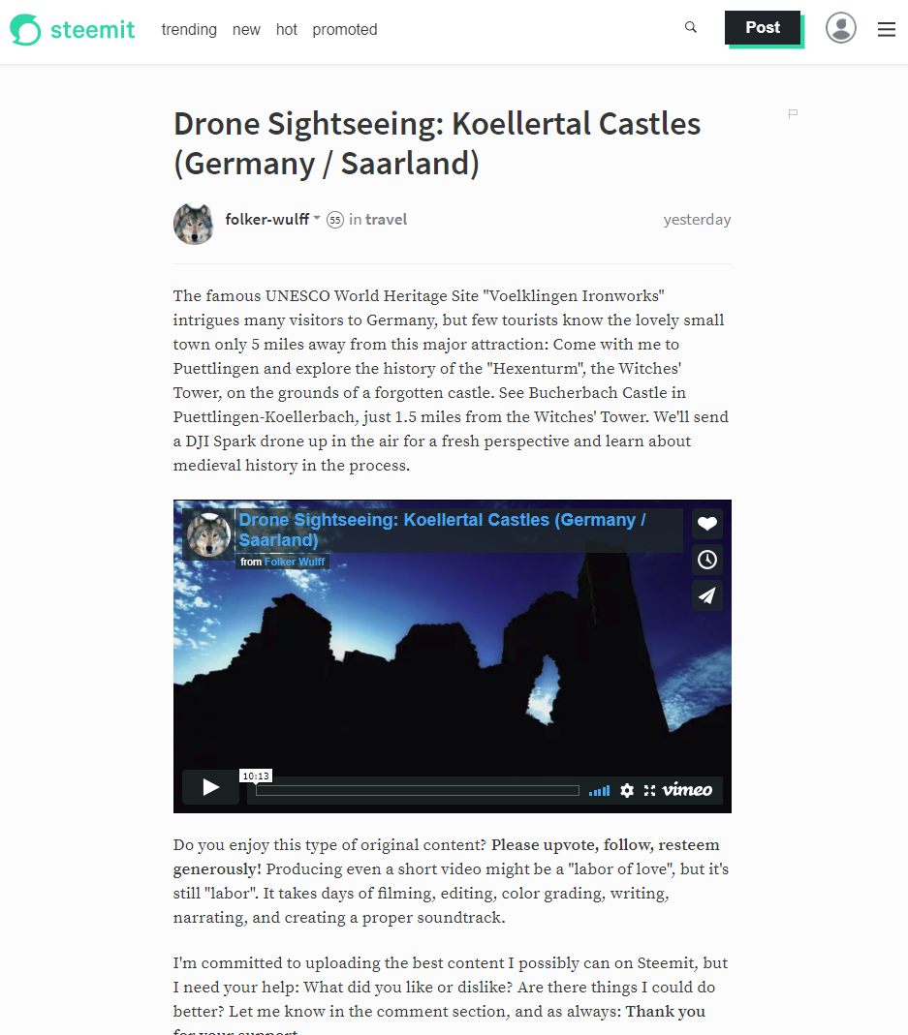
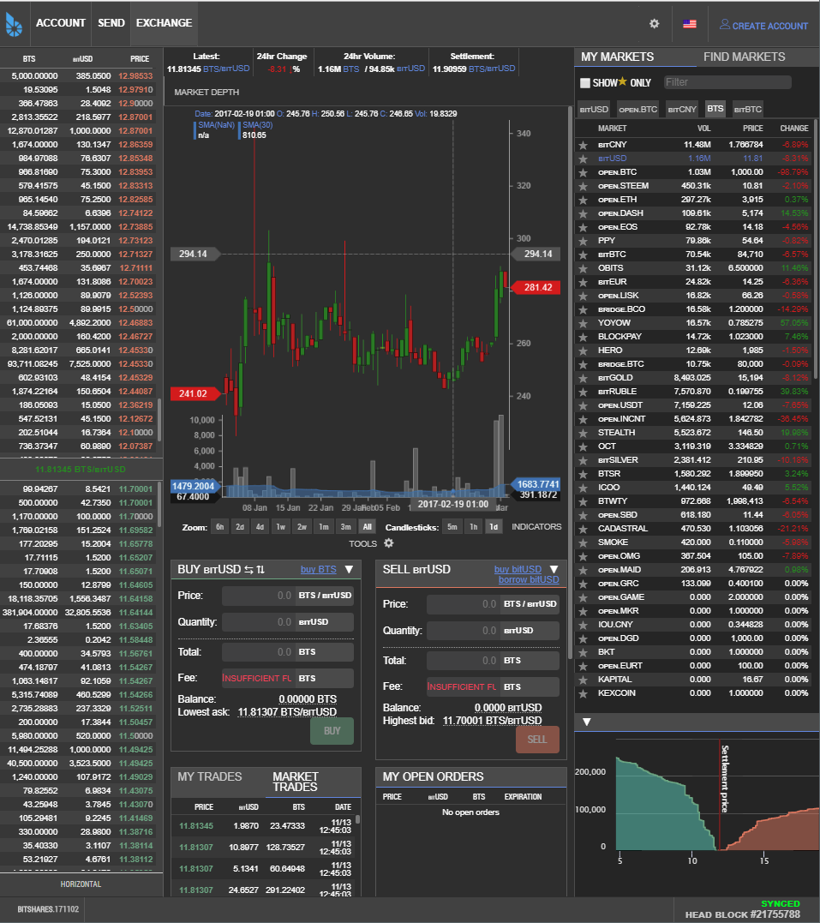
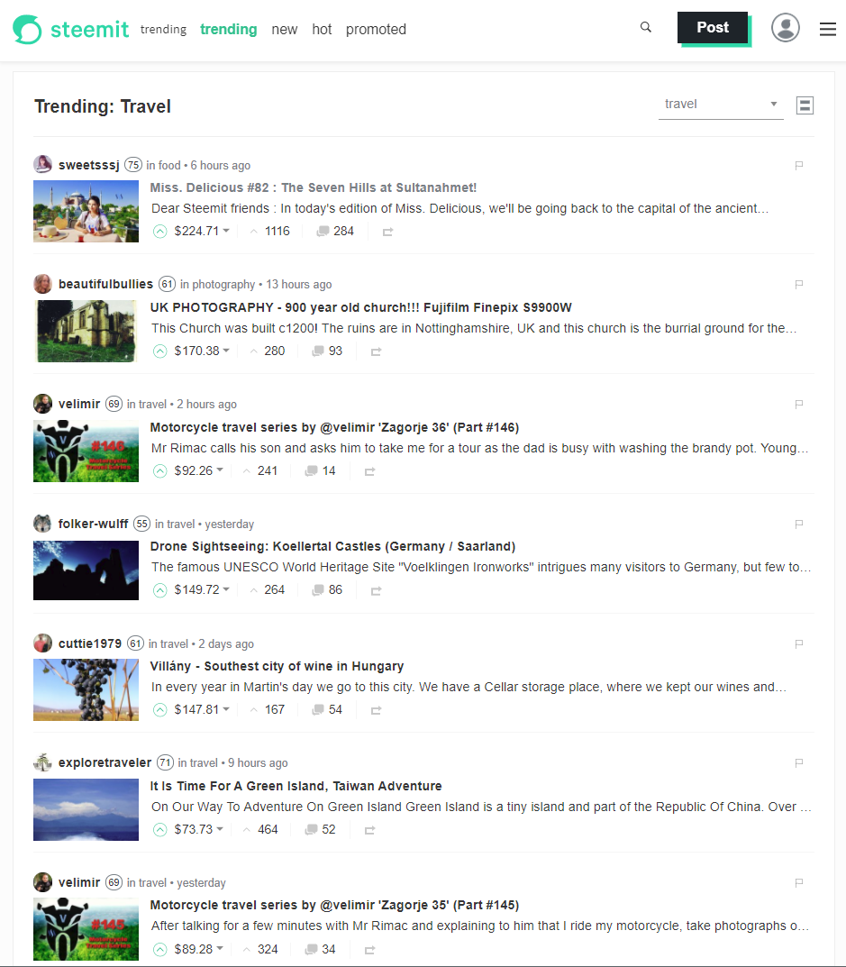
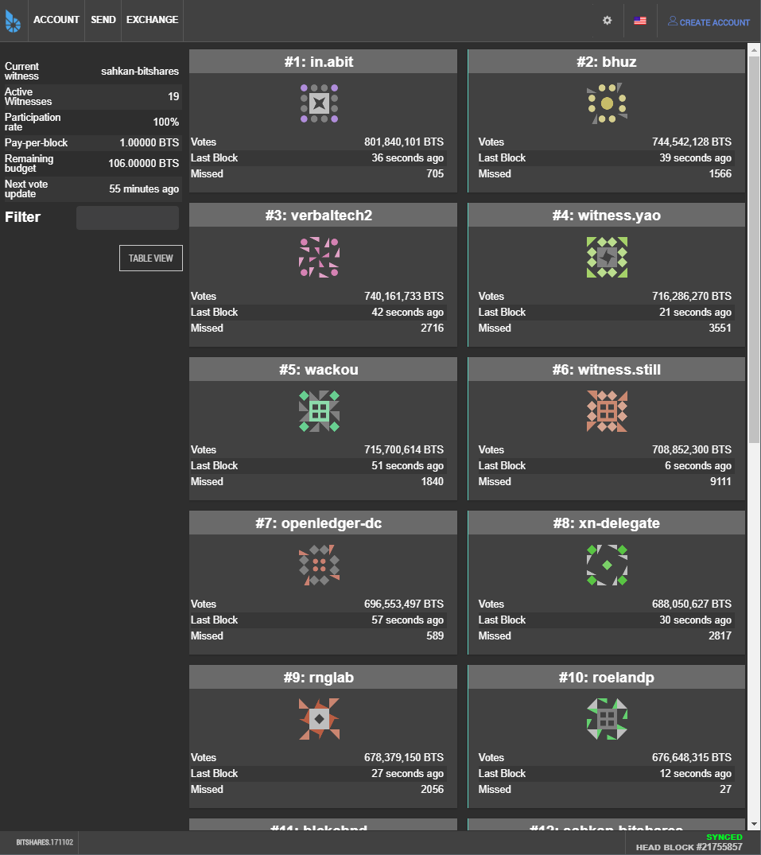
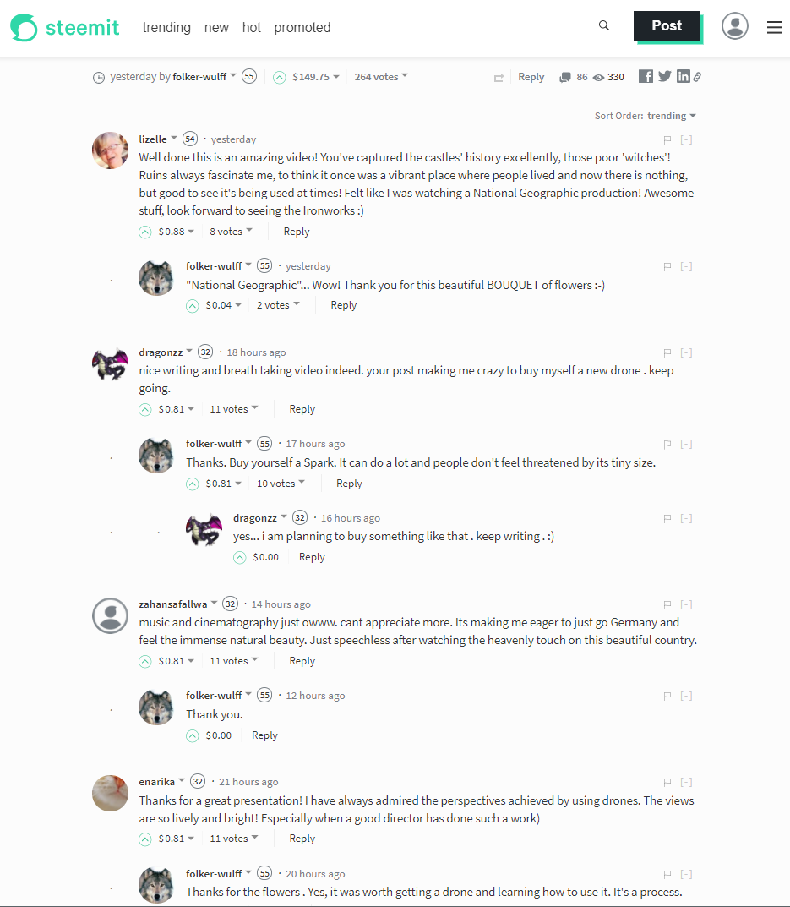
Source: bitshares.org & steemit.com

Slide 33
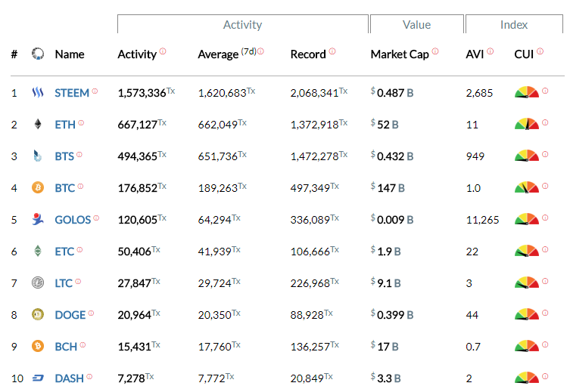
most active blockchains
Source: blocktivity.info

Slide 34
summary
Revolution or evolution?
Extremely business oriented
Pragmatic approach: people are integral part of the process

Slide 35
About Tokenika - OUR ROLE IN EOS ECOSYSTEM
Applications
Development Tools
DPOS Infrastructure
EOS
block.one

Slide 36
Thank you
EOS - official website
www.eos.io
Any questions?
Presented by
www.tokenika.io contact@tokenika.io
facebook.com/groups/Tokenika facebook.com/groups/EOSPolska

